Slide 1
CSCI 570 Exam 1 Review

Slide 2
Stable Matching
Ziyi Wu

Slide 3
Stable Matching
We have a complete bipartite graph with two sides, M and W
Each member on one side has a strict preference order for each member of the other side.
Our goal is a stable matching
No instabilities: where in pairs (m, w) and (m’, w’)
m prefers w to w’ and
w’ prefers m to m’

Slide 4
Gale Shapley Algorithm
Initialize all m in M and w in W to be free
While there is a man m that is free and has not proposed to every woman:
Let w be m’s highest ranking women he has not proposed to
If w is free or prefers m to her current partner m’:
engage(m,w)
m’ becomes free if exists
Endif
Endwhile

Slide 5
Gale Shapley Properties
Runtime: n^2
GS will always correctly return a stable matching
The proposing side receives their best possible stable matches
The accept/reject side receives their worst possible stable matches

Slide 6
Question 1
A zoo wishes to pair up their warthogs and manatees based on their preferences.
Run the GS algorithm with the warthogs proposing in alphabetical order, and then again with the manatees proposing. What are the stable matchings returned by the algorithm?
Let improvement be a measure of how many ranks better a match is. How many ranks of improvement did manatees get due to proposing?
Manatee | 1 | 2 | 3
Ally | Bethany | Cho | Alex
Brad | Alex | Bethany | Cho
Charlie | Bethany | Cho | Alex
Warthog | 1 | 2 | 3
Alex | Ally | Brad | Charlie
Bethany | Brad | Charlie | Ally
Cho | Charlie | Ally | Brad

Slide 7
Solution 1
Alex -> Ally (e)
Bethany -> Brad(e)
Cho -> Charlie(e)
Final Matching (Alex, Ally), (Bethany, Brad), (Cho, Charlie)
Ally -> Bethany (e)
Brad -> Alex (e)
Charlie -> Bethany (e) Ally (f)
Ally -> Cho(e)
Final Matching (Alex, Brad), (Bethany, Charlie), (Cho, Ally) - Improvement: 3

Slide 8
Question 2
Prove that in the male-propose version of the GS algorithm, at most one man ends up with his worst possible choice.

Slide 9
Solution 2
Suppose that two men m₁ and m₂ end up with their worst possible choices, w₁ and w₂ respectively. WLOG, let m₂ be the second man to propose to his worst woman. This means that he must have proposed to every woman excluding w₂.
And given that w₁!= w₂, and that m₁ must have proposed to his entire preference list, we know that w₂ must have been proposed to by m₁ at some point previously as well. This means that by the last round, every woman has been proposed to.

Slide 10
In GS, we know that once a woman is proposed to, she stays engaged for the rest of the run because she can only reject because she can only reject or engage. So we now know that every woman is engaged.
But there are the same number of men and women so every man must be engaged as well. However our premise was that m₂ is proposing to w₂ which means he must be free.
This is a contradiction, thus it is not possible for two men to end up with their worst possible partners

Slide 11
Asymptotic Notation
Ziyang Guo

Slide 12
Asymptotic Notation
Examples:
 | f(n) | g(n)
f(n) = O(g(n)) | n | n²
f(n) = 𝛀(g(n)) | n | log(n)
f(n) = 𝚹(g(n)) | 2n² | 5n²+3n

Slide 13
Asymptotic Notation
Arrange these functions under the O notation using only = (equivalent) or < (a strict subset of):
(a) n²; (b) n; (c) log(n); (d) nlog(n); (e) 2^{n}; (f) n^{n}
Sol:
Logarithmic < Polynomial < Exponential
c < b < d < a < e < f

Slide 14
Amortized Analysis
Devarsh Amin

Slide 15
Amortized Analysis
If we calculate the time complexity for a series of operations which are not unique , we tend to take time complexity for all the operations equal to the most time taken by an operation in that sequence.
This seems very pessimistic approach as the actual time taken will be much less than this, since some operations take less time than the worst case time taken per each step.
On the other hand, taking best case for each operation seems too much optimistic, therefore we need to find worst case time taken for each step or operation and then amortize it or disburse it among ‘n’ steps.

Slide 16
Suppose we perform sequence of n operations where i^{th} operation costs i if it is a power of 3 or costs 1 otherwise. Using aggregate method calculate the amortized cost for each operation.
Problem-1
Solution:
Let us prepare a table for representing cost for sequence of operations .
We consider number of operations such that it is equal to power of 3 .
If the index of operation is power of 3 we take its ‘ = index , else we take 1

Slide 17
Aggregate Method:-
Operation | Cost
1 | 1 (since its first operation)
2 | 1
3 | 3
4 | 1
5 | 1
6 | 1
7 | 1
8 | 1
9 | 9

Slide 18
Total cost : Cost for steps with index as power of 3 + Cost for steps not power of 3
= (3^{n} -1)*3 / 2 + (3^{n} - log(3^{n} ))
Amortized Cost = Σ_{lim n→∞} ((3^{n} -1)*3 / 2 + (3^{n} - log(3^{n} ))) / 3^{n}
A.C = O(3)

Slide 19
Accounting Method:-
We find the amortized cost for each operation in this method by charging each operation by certain amount. The main emphasis of the accounting method is that, our account should never go negative of the total cost till the point, in the other words we should be charging each operation enough to cover for its cost and future operations cost if they exceed what the operation is assigned.
Let us calculate how much tokens should we assign to each of our operation.
Total cost for n operations = Cost for steps with index as power of 3 + Cost for steps not power of 3
Cost < n + Σ^{logn}_{i=0} 3^{i} = n+ 3n -1= 4n -1
Hence , we can assign each step cost of 4 since , it would be amortized by slightly less than 4n for n steps

Slide 20
Index | Token | Token Used | Account
1 | 4 | 1 | 3
2 | 4 | 1 | 6
3 | 4 | 3 | 7
4 | 4 | 1 | 10
5 | 4 | 1 | 13
One can never exceed the token in bank or go negative in this method, Since the Amortized cost per operation is constant , Total cost for n operations , O(n)

Slide 21
Problem -2
Suppose we have a dynamic array which we expand , when the array is not completely filled, but filled till certain percentage. We do this to make sure we never run out of memory. Prove that the amortized cost for an operation still remains constant.
Solution:
Let us denote k be the factor representing the filled part of array, where 0<k<1.
For such problem , we always break down total cost in 2 parts:-
Cost for inserting an element
Cost for copying the elements from previous array to new array.
Cost of Insertion will always remain constant and will be equal to number of operations.
The cost of copying the elements can at most increase in geometric progression when k =1 and can never exceed that, which in turn will never be upper bound of total number of operations. Therefore, A.C for such operation would always be constant.

Slide 22
Let us understand math behind by taking k =¾.
Insert | Old | New | Cost for Copy
1 | 1 | - | -
2 | 1 | 2 | 1
3 | 2 | 4 | 2
4 | 4 | 4 | -
5 | 4 | 8 | 4
6 | 8 | 8 | -
7 | 8 | 8 | -
8 | 8 | 16 | 7
9 | 16 | 16 | -

Slide 23
Therefore, Total Cost = Total number of Insertions + Cost to copy
Here we have Total Elements= 2 ^{n}+1
Cost to Copy till 2^{n}+1 = 1+2+4+7...<1+2+4+8+..
As we can see the cost to copy will always be less than sum of G.P till the last insert for 0<k<1
Therefore, Cost to Copy till 2 ^{n}+1 ≤ 2^{n+1}-1
Therefore, Total Cost = 2 ^{n}+1 + 2^{n+1}-1
Therefore Amortized cost = 3.2^{n}/(2 ^{n}+1) = O(3)
Hence , Amortized cost for insertion in such schema will always be constant
.

Slide 24
Problem - 3
Suppose you have a data structure such that sequence of n operations has Worst-Case Cost of n²log n , what can be the highest actual cost per operation?
Solution: Since the Worst-Case Cost for n operations is n²log n, this is the highest cost an operation can possibly have in that sequence.
For example, 1,n,1,nlogn,.....n²log n

Slide 25
Problem - 4
(T/F) The actual cost of an operation in a sequence of n operations , can be higher than A*n, where A is the amortized cost for that sequence of operations
Solution : False
If A is the amortized (average) cost of the operations in that sequence, then A*n represents the total cost of that sequence of operations. So a given operation cannot have a cost greater than that.

Slide 26
Greedy Part 1
TA: Alex Wang

Slide 27
Greedy: 2 Common Methods of Proof of Optimality
stay-ahead: an inductive method to show that for each step you take, you are always ahead of any other solution according to some metric
exchange: show that for your greedy solution, any swaps between steps/elements cannot achieve a better result

Slide 28
Problem 1
For a graph G = (V, E), a vertex cover of G is a set of vertices that includes at least one endpoint of each edge of G. Assuming our graph G is a tree, find an algorithm that finds a minimum vertex cover of G.

Slide 29
Solution 1
Let S be the set of vertices that will be the vertices we return. If our graph G has no vertices or only 1 vertex, return S. Otherwise, add all vertices 1 layer above all our leaf vertices in the tree to S, and remove the vertices and its adjacent edges from G, as well as the leaf vertices. Recursively apply this step until we end up with 1 or no vertices in G. Return S. This is optimal because we have to cover the lead edges regardless, so our cover will always either include the leaf node itself or its parent. If we include its parent, we cover just as much if not more than if we select the leaf node. The problem then reduces to a vertex cover for a subset of the original tree. This subset is smaller than the one we would have gotten from choosing the leaf node, and a vertex cover of tree is at least as large as the vertex cover of a subset of it.

Slide 30

Problem 2
Given an array of distinct integers A = [a₁, a₂, …, a_{n}] and a sequence p of numbers p = [1, 2, …, n], rearrange the numbers in p such that is minimized.

Slide 31
Solution 2
Consider 2 real numbers ai and aj, and 2 other real numbers, pi and pj, where ai < aj and pi < pj. WLOG, assume that all 4 of these numbers are distinct. There are 6 possible orderings given these constraints: ai < aj < pi < pj, ai < pi < aj < pj, ai < pi < pj < aj, pi < ai < aj < pj, pi < ai < pj < aj, and pi < pj < ai < aj. For each of these cases, we want to show that |ai - pi| + |aj - pj| ≤ |ai - pj| + |aj - pi|, which basically means that we cannot get a smaller distance if we exchange elements pi and pj. Therefore if we have ai < aj if and only if pi < pj for all i, j, we will have the minimum distance. We can store the index of the elements in A in a hashmap h. We then sort A and pair it with p, and reorder p according to indices of h. Since our algorithm produces elements ai and pi with these properties, our algorithm produces a minimum distance.

Slide 32
In the previous proof, we left out details about showing |ai - pi| + |aj - pj| ≤ |ai - pj| + |aj - pi| for each of 6 cases. Here is an example of showing that this is true for the case for ai < pi < aj < pj. Define the distance between ai and pi, pi and aj, and aj and pj, as d1, d2, and d3 respectively. Then |ai - pi| + |aj - pj| = d1 + d3 ≤ d1 + 2*d2 + d3 = |ai - pj| + |aj - pi|. You can verify that the other cases are true as well. In the exam, there will not be this much detail involved in a proof, and if there is, we will state which parts can be skipped or assumed to be true.

Slide 33
Greedy Part 2
TA: Tiancheng Lin

Slide 34
T/F questions (3 min)
A greedy algorithm always makes the choice that looks best at the moment.
The shortest path between two points in a graph will not change if the weight of each edge is increased by an identical number.
Gale Shapley algorithm is based on greedy technique.

Slide 35
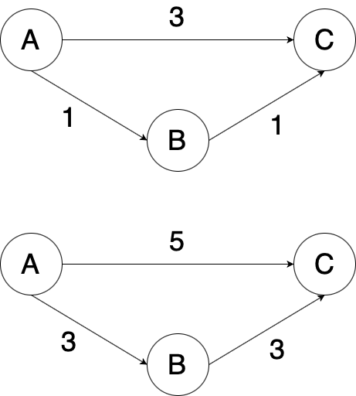
T/F questions
A greedy algorithm always makes the choice that looks best at the moment.
Answer: True
The shortest path between two points in a graph will not change if the weight of each edge is increased by an identical number.
Answer: False
Gale Shapley algorithm is based on greedy technique.
Answer: True

Slide 36
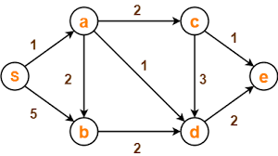
Question 1 (3 min)
Find shortest path for each vertex from S using Dijkstra’s Algorithm.

Slide 37
Question 1
Find shortest path for each vertex from S using Dijkstra’s Algorithm.
a | b | c | d | e
1 | 5 | INF | INF | INF
 | 3 | 3 | 2 | INF
 | 3 | 3 |  | 4
 |  | 3 |  | 4
 |  |  |  | 4

Slide 38
Question 2 (5 min)
Given an array of meeting time intervals where intervals[i] = [start_i, end_i], find the minimum number of conference rooms required. i.e. [[0,30], [5,10], [15,20]]
Example: meeting 1: [0,30],meeting 2: [5,10], meeting 3: [15,20], minimum number of conference rooms required is 2, because meeting 2 and meeting 3 can share the same room but meeting 1 must reserve its own room.
(Hints: Greedy + priority queue )

Slide 39
Question 2
Given an array of meeting time intervals where intervals[i] = [start_i, end_i], find the minimum number of conference rooms required. i.e. [[0,30], [5,10], [15,20]]
Algorithm:
Sort the given meetings by their start time.
Initialize a new min-heap and add the first meeting's ending time to the heap. We simply need to keep track of the ending times as that tells us when a meeting room will get free.
For every meeting room check if the minimum element of the heap i.e. the room at the top of the heap is free or not, which means we assign this meeting to the earliest-available room.
If the room is free, then we extract the topmost element and add it back with the ending time of the current meeting we are processing; If not, then we allocate a new room and add it to the heap.
After processing all the meetings, the size of the heap will tell us the number of rooms allocated. This will be the minimum number of rooms needed.
Time complexity:
O(nlogn) for sorting, N meetings * (O(1) for getMin + O(logn) for extractMin +O(logn) for insert) = O(nlogn)

Slide 40
Question 2
Given an array of meeting time intervals where intervals[i] = [start_i, end_i], find the minimum number of conference rooms required. i.e. [[0,30], [5,10], [15,20]]
Proof of correctness:
Assume that the optimal solution does not assign [x1,y1] to the room of the earliest-end meeting: it assigns [x1,y1] to another free room ended in x0. If we can assign [x1,y1] to this free room, then the later meeting, [x2,y2] can also assign to the earliest-end meeting because x0<=x1<=x2, the result of both of the strategy ends with two rooms ended in y1 and y2, so our solution is the same as optimal solution, which means that this strategy is optimal.
Assume that when we assign [x1,y1], an optimal solution assigns [x2,y2] first where x1 < x2.
y1 <= x2. Then in our solution, we don’t need to assign extra meeting room, but optimal solution needs an extra room because x1 < y1 <= x2 < y2, which means that the meeting [x1,y1] cannot reuse the same meeting room in the optimal solution.
y1 > x2. Then both of solutions needs an extra room and ends with two meeting rooms, which end with y1 and y2. So optimal solution is not better than our solution.
We prove that our solution is not worse than optimal solution, hence this strategy is optimal.

Slide 41
MST
TA: Rong Wang

Slide 42
MST 1
[T/F] If all edge weights of a given graph is the same, then every spanning tree of that graph is minimum.
True.
Spanning tree: Any tree that covers all nodes of a graph is called a spanning tree.

Slide 43
MST 2
[T/F] If the weight of each edge in a connected graph is distinct, then the graph contains exactly one unique minimum spanning tree.
True.
Proof: Suppose two MSTs T1 and T2 of G,
E = set of edges that is in either T1 or T2 but not both.
e is the min edge in E.
Suppose e is not in T2. Adding e to T2 creates a cycle. Then in this cycle, at least one edge, say f, is not in T1. Since e is te min edge in E, then w(e) <= w(f). And all edges have distinct weights, w(e) < w(f). Replacing f with e results in a new spanning tree with less weight than T1 and T2. Therefore, contradiction.

Slide 44
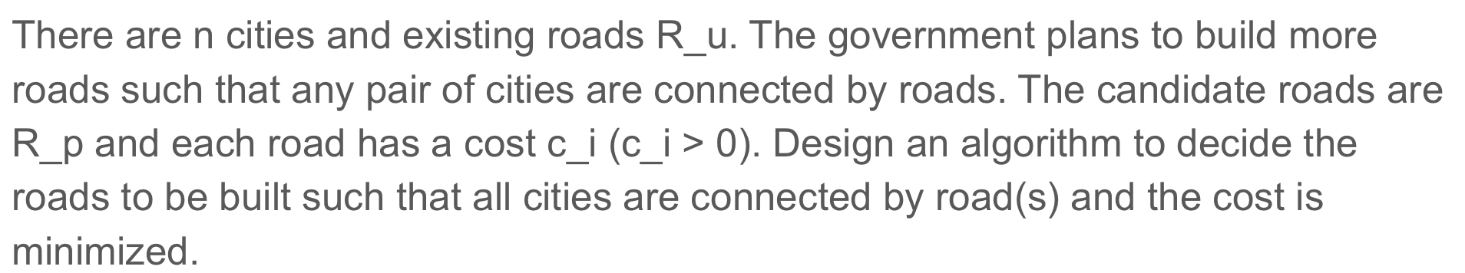
MST 3

Slide 45
MST 3
1: Construct a graph with n nodes.
2: Add R_u to the graph and set edge weight to be 0.
3: Add R_p to the graph and set edge weights to be the cost.
4: Run MST algorithm, return roads that are in both R_p and MST.
1: Get connected components of the graph with R_u.
2: Merge nodes and edges.
3: Add R_p, run MST.

Slide 46
Shortest Path
Nan Xu

Slide 47
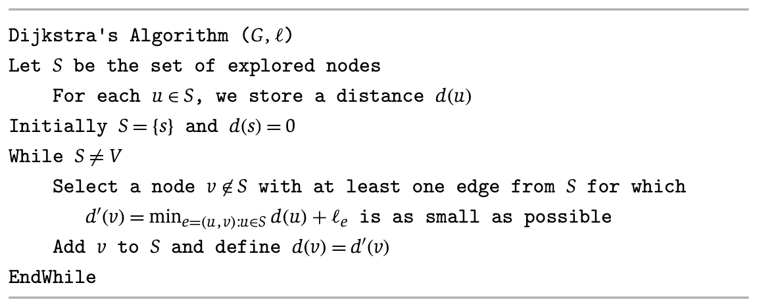
Recap: Dijkstra’s Algorithm
Step 1
3
y
s->u=1
u
1
1
1
d(s)=0
4
s->x=4
s
x
2
2
Set S:
Nodes already explored
2
v
s->v=2
3
z

Slide 48
Recap of Dijkstra’s Algorithm
s->u->y=4
Step 2
3
y
d(u)=1
u
1
1
1
d(s)=0
s->u->x=2
s->x=4
s
4
x
2
2
Set S:
Nodes already explored
2
v
s->v=2
3
z

Slide 49
Recap of Dijkstra’s Algorithm
Step 3
s->u->y=4
3
y
d(u)=1
u
1
1
1
d(s)=0
s->u->x=2
s->x=4
s->v->x=4
s
4
x
2
2
Set S:
Nodes already explored
2
v
d(v)=2
s->v->z=5
3
z

Slide 50
Recap of Dijkstra’s Algorithm
Step 4
s->u->y=4
s->u->x->y=3
3
y
d(u)=1
u
1
1
1
d(s)=0
s
4
x
d(x)=2
2
2
Set S:
Nodes already explored
2
v
d(v)=2
s->v->z=5
s->u->x->z=4
3
z

Slide 51
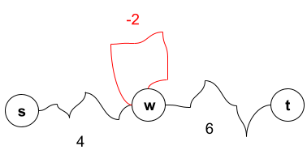
NOTE: Negative Weights - Negative Cycles
Negative cycles: if some cycle has a negative total cost, we can make the s-t path as low cost as we want
s->w->t: 4+6=10
s->w (cycle once)->t: 4-2+6=8
s->w (cycle twice)->t: 4-2*2+6=6
…
s->w (cycle N times)->t: 4-2*N+6=-∞, when N->∞

Slide 52
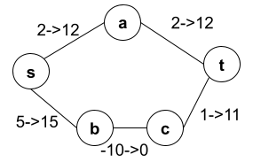
NOTE: Negative Weights - Solve with a Big Number?
Adding a large number M to each edge DOES NOT work
New cost of path P: M*len(P)+old_cost(P)
When M is big, the number of hops (path length) will dominate rather than old path cost
Before: s-b-c-t (-4) is shorter than s-a-t (4)
After adding 10 to all edges: s-a-t (24) is shorter than s-b-c-t (26)
Solution: Bellman-Ford in Dynamic Programming Section

Slide 53
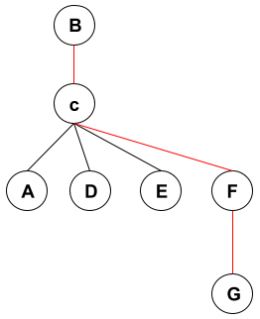
Problem I
The diameter of a graph is the maximum of the shortest paths’ lengths between all pairs of nodes in graph G.
Design an algorithm which computes the diameter of a connected, undirected, unweighted graph in O(mn) time, and explain why it has that runtime.
Diameter of this graph is: 3

Slide 54
Solution I
Unweighted graph => BFS can be used for shortest path search for each source node in O(m+n)
For one source node s, report the maximum layer reached
Repeat BFS for each node in O(n)
Total time complexity: O(n(m+n))
Connected graph, the number of edges are at least n-1, at most n(n-1)/2, hence n=O(m)
=> O(m+n) is O(m)
total time complexity: O(nm)

Slide 55
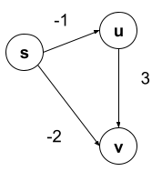
Problem II:
Dijkstra’s algorithm works correctly on a directed acyclic graph even when there are negative-weight edges.
TRUE or FALSE

Slide 56
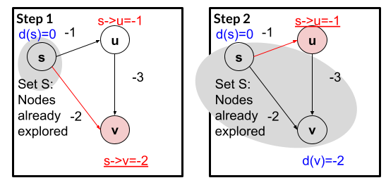
Solution II
False
Dijkstra’s algorithm: d(v)=-2
Actual shortest path: s-u-v, with cost -4

Slide 57
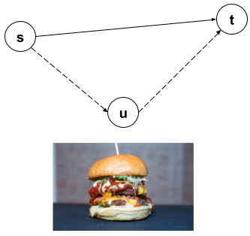
Problem III
Suppose that you want to get from vertex s to vertex t in a connected undirected graph G = (V; E) with positive edge costs, but you would like to stop by vertex u (imagine that there are free burgers at u) if it is possible to do so without increasing the length of your path by more than a factor of ɑ
Describe an efficient algorithm in O( |E| log |V| ) time that would determine an optimal s-t path given your preference for stopping at u along the way if doing so is not prohibitively costly. (In other words, your algorithm should either return the shortest path from s to t, or the shortest path from s to t containing u, depending on the situation.)

Slide 58
Solution III
Positive edges => Dijkstra’s algorithm for shortest path from source node s, and from source node u
shortest path from s => we know d_{s}(t) and d_{s}(u)
Shortest path from u => we know d_{u}(t)
Compare d_{s}(u) + d_{u}(t) and ɑ*d_{s}(t)
If d_{s}(u) + d_{u}(t) <= ɑ*d_{s}(t), stop by u for burger!
If d_{s}(u) + d_{u}(t) > ɑ*d_{s}(t), go directly from s to t
Time complexity
Connected graph: |V|=O(|E|)
Running Dijkstra’s algorithm twice:
Binary heap: O((|V| +|E|) log |V|) => O( |E| log |V| )
Fibonacci heap: O(|E|+|V|log|V|) => O( |E| log |V|)

Slide 59
DIVIDE AND CONQUER
TA: Rutu Desai

Slide 60
Question 1
A polygon is called convex if all of its internal angles are less than 180°and none of the edges cross each other. We represent a convex polygon as an array V with n elements, where each element represents a vertex of the polygon in the form of a coordinate pair (x, y). We are told that V [1] is the vertex with the least x coordinate and that the vertices V [1], V [2], . . . , V [n] are ordered counter-clockwise. Assuming that the x coordinates (and the y coordinates) of the vertices are all distinct, do the following:
(a) Give a divide and conquer algorithm to find the vertex with the largest x coordinate in O(log n) time.
(b) Give a divide and conquer algorithm to find the vertex with the largest y coordinate in O(log n) time.

Slide 61
Solution
(a). Since V[1] is known to be the vertex with the minimum x-coordinate (leftmost point), moving counter-clockwise to complete a cycle must first increase the x-coordinates and then after reaching a maximum (rightmost point), should decrease the x-coordinate back to that of V[1]. Thus, V_{x}[1 : n] is a unimodal array, and so it is synonymous with detecting the location of the maximum element in the array.
Algorithm:
(1) If n = 1, return V_{x}[1].
(2) If n = 2, return max{V_{x}[1], V_{x}[2]}.
(3) k ← ᒥn/2ᒣ.
(4) If V_{x}[k] > V_{x}[k − 1] and V_{x}[k] > V_{x}[k + 1], then return V_{x}[k].
(5) If V_{x}[k] < V_{x}[k − 1] then call the algorithm recursively on V_{x}[1 : k − 1], else call the algorithm recursively on V_{x}[k + 1 : n].

Slide 62
Solution
(b). Let p denote the index at which the x-coordinate was maximized. Observe that joining V[1] and V[p] by a straight line divides the polygon into an upper half and a lower half and the vertex achieving the maximum y-coordinate must lie above this line. The counter-clockwise traversal V_{y}[p] → V_{y}[p+ 1] → · · · → V_{y}[n] → V_{y}[1] is unimodal and we need to detect the location of the maximum element of this array. So, considering the same algorithm as above with this new array [V_{y}[p], V_{y}[p + 1], . . . , V_{y}[n], V_{y}[1]] will return the vertex with the maximum y-coordinate.
The recurrence equation is T(n) ≤ T(n/2) + Θ(1).
Invoking Master’s Theorem gives T(n) = O(log n).

Slide 63
DIVIDE AND CONQUER
TA: Saumil Dedhia

Slide 64
Question 2
Each ship is located at an integer point on the sea represented by a cartesian plane, and each integer point may contain at most 1 ship.
You have a function Sea.hasShips(topRight, bottomLeft) which takes two points as arguments and returns true If there is at least one ship in the rectangle represented by the two points, including on the boundary.
Given two points: the top right and bottom left corners of a rectangle, return the number of ships present in that rectangle. It is guaranteed that there are at most 10 ships in that rectangle.
Example :
ships = [[1,1],[2,2],[3,3],[5,5]], topRight = [4,4], bottomLeft = [0,0]
Algorithm should output = 3

Slide 65
Solution
Hint 1 : Divide the query rectangle into 4 rectangles.
Hint 2 : Use recursion to continue with the rectangles that has ships only.

Slide 66
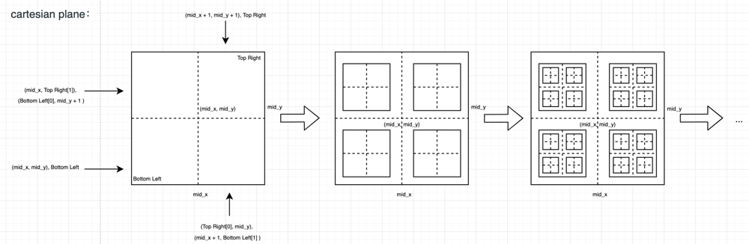
Solution - Visualization

Slide 67
Solution
Step 1 : Base Condition:
if (!sea.hasShips(topRight, bottomLeft))
return 0;
if (topRight[0] == bottomLeft[0] && topRight[1] == bottomLeft[1])
return 1;
Step 2 : Divide
int midX = (topRight[0] + bottomLeft[0])/2;
int midY = (topRight[1] + bottomLeft[1])/2;

Slide 68
Solution
Step 3 : Conquer
countShips(sea, new int[]{midX, midY}, bottomLeft) +
countShips(sea, topRight, new int[]{midX+1, midY+1}) +
countShips(sea, new int[]{midX, topRight[1]}, new int[]{bottomLeft[0], midY+1}) +
countShips(sea, new int[]{topRight[0], midY}, new int[]{midX+1, bottomLeft[1]});

Slide 69
Time Complexity Analysis using Master’s Theorem
Time complexity: O(n) n is the side of the rectangle
T(n) = 4xT(n/2) + O(1)
Apply master theorem: n^(log(4)4) = n^2 is O(O(1)). So T(n) = O(n^2)
Complexity is still the same but, we significantly improve the time complexity practically since we would not check any of the blocks that don’t have any ships.

Slide 70
BFS and DFS
TA: Adwaita Jadhav

Slide 71
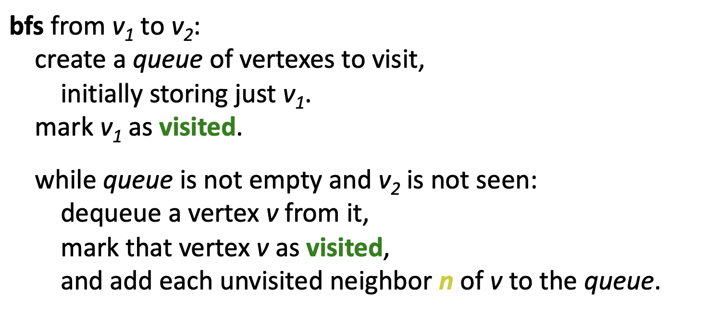
BFS
Time Complexity: O(V+E)

Slide 72
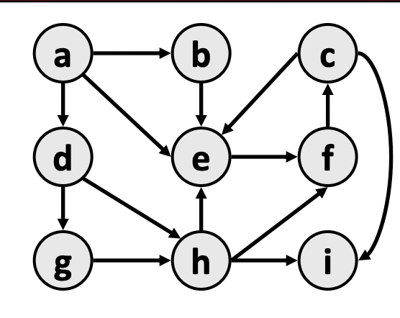
Question: BFS traversal of following graph.
a->b (since e is already visited we stop)
a->d->g (since h is already visited we stop)
->h->i (since e and i are already visited)
a->e->f->c

Slide 73
Some Observations
optimality:
– always finds the shortest path (fewest edges).
– in unweighted graphs, finds optimal cost path.
– In weighted graphs, not always optimal cost.
retrieval: harder to reconstruct the actual sequence of vertices or edges in the path once you find it
– conceptually, BFS is exploring many possible paths in parallel, so it's not easy to store a path array/list in progress
– solution: We can keep track of the path by storing predecessors for each vertex (each vertex can store a reference to a previous vertex).

Slide 74
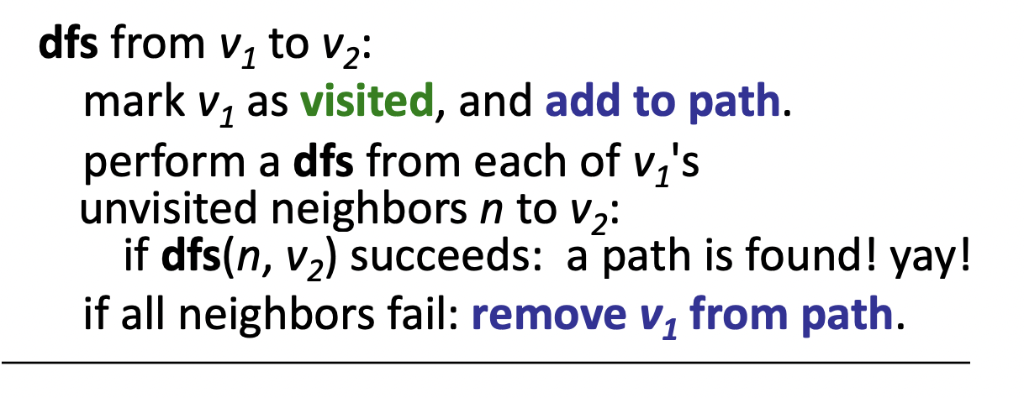
DFS
• Depth-first search (DFS): Finds a path between two vertices by exploring each possible path as far as possible before backtracking.
– Often implemented recursively.
– Many graph algorithms involve visiting or marking vertices.
– Time Complexity: O(V+E)

Slide 75
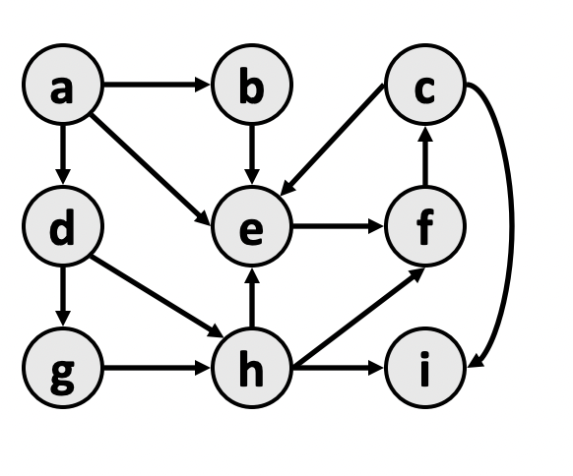
Question: Find a path from a to h
a->e->f->c->i
Backtrack to c, no more unvisited neighbors
Backtrack to f, no more unvisited neighbors
Backtrack to e, no more unvisited neighbors
Backtrack to a, univisited neighbors b and d
a->d->g->h
Observation: we could also go from d->h and that would lead to shortest path. But DFS does not guarantee shortest path, but it guarantees if path exists or not.

Slide 76
Heaps
Rachitha Kagalvadi

Slide 77
Question 1
Merge two binomial heaps
B0B1B2B4 and B1B4

Slide 78
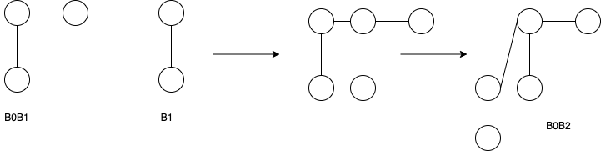
Example-
11 + 10 = 101 → B2B0

Slide 79
Solution
B0B1B2B4 → 10111
B1B4 → 10010
Perform Binary addition
Result → 101001
Heap after merging → B5B3B0

Slide 80
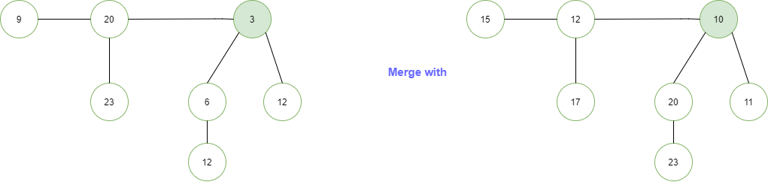
Question 2
14

Slide 81
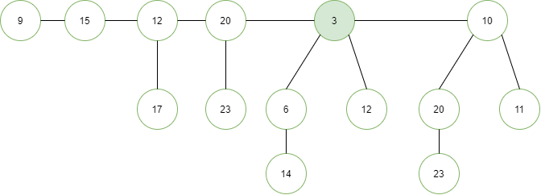
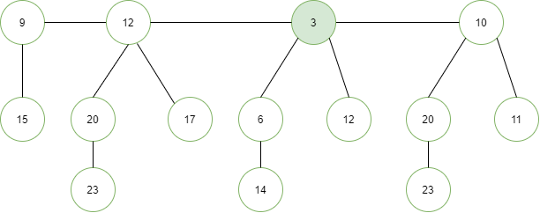

Slide 82
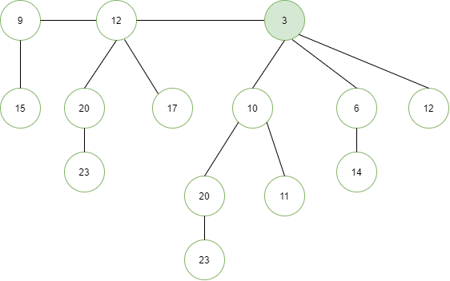

Slide 83
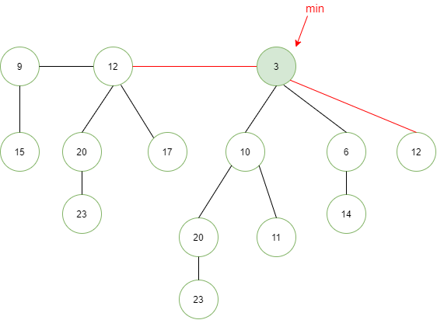
deleteMin()

Slide 84
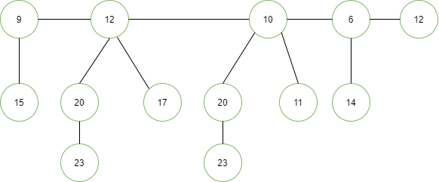

Slide 85
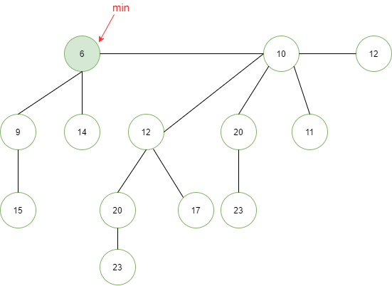

Slide 86
Question 3 (T/F)
The smallest element in a binary max-heap of size n can be found with at most n/2 comparisons.

Slide 87
Solution
True. In a max heap, the smallest element is always present at a leaf node. So we need to check for all leaf nodes for the minimum value → how many leaf nodes are there?
ceil(n/2) leaf nodes. → Therefore, we will only have to do at most n/2 comparisons.

